Slide 1
JavaScript Unit Testing
part 2
by Sofiia Matsyhin

Slide 2
Jasmine

Slide 3
What is Jasmine?
Jasmine is an open-source testing framework for JavaScript. It aims to run on any JavaScript-enabled platform, to not intrude on the application nor the IDE, and to have easy-to-read syntax.

Slide 4
Jasmine has many features such as:
It’s fast and has low overhead and no external dependencies.
It’s a batteries included library and offers everything you need for testing your code.
It’s available both for Node and the browser.
It can be used with other languages like Python and Ruby.
It does not require the DOM.
It provides a clean and easy to understand syntax and also a rich and straightforward API.
We can use natural language to describe the tests and the expected results.

Slide 5
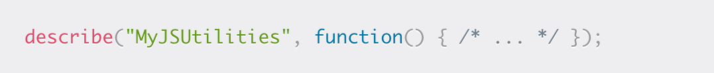
Suites
A suite groups a set of specs or test cases. It’s used to test a specific behavior of the JavaScript code that’s usually encapsulated by an object/class or a function. It’s created using the Jasmine global function describe() that takes two parameters, the title of the test suite and a function that implements the actual code of the test suite.
You can temporarily disable a suite using the xdescribe() function. It has the same signature (parameters) as a describe() function which means you can quickly disable your existing suites by simply adding an x to the function. Specs within an xdescribe() function will be marked pending and not executed in the report.

Slide 6
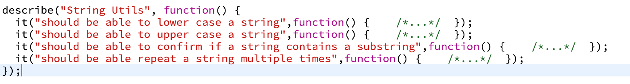
Specs
A spec declares a test case that belongs to a test suite. This is done by calling the Jasmine global function it() which takes two parameters, the title of the spec (which describes the logic we want to test) and a function that implements the actual test case.
A spec may contain one or more expectations. Each expectation is simply an assertion that can return either true or false. For the spec to be passed, all expectations belonging to the spec have to be true otherwise the spec fails.

Slide 7
Expectations
Expectations are created using the expect() function that takes a value called the actual (this can be values, expressions, variables, functions or objects etc.). Expectations compose the spec and are used along with matcher functions (via chaining) to define what the developer expect from a specific unit of code to perform.
A matcher function compares between an actual value (passed to the expect() function it's chained with) and an expected value (directly passed as a parameter to the matcher) and returns either true or false which either passes or fails the spec.

Slide 8
Built-In Matchers
Jasmine provides a rich set of built-in matchers. Let’s see some of the important ones:
toBe() for testing for identity,
toBeNull() for testing for null,
toBeUndefined()/toBeDefined() for testing for undefined/not undefined,
toBeNaN() for testing for NaN (Not A Number)
toEqual() for testing for equality,
toBeFalsy()/toBeTruthy() for testing for falseness/truthfulness etc.

Slide 9
Using beforeEach() and afterEach()
For initializing and cleaning your specs, Jasmine provides two global functions, beforeEach() and afterEach():
The beforeEach function is called once before each spec in the suite where it is called.
The afterEach function is called once after each spec in the suite where it's called.
For example, if you need to use any variables in your test suite, you can simply declare them in the start of the describe() function and put any initialization or instantiation code inside a beforeEach() function. Finally, you can use the afterEach() function to reset the variables after each spec so you can have pure unit testing without the need to repeat initialization and cleanup code for each spec.

Slide 10
Mocha

Slide 11
What is Mocha?
Mocha is a JavaScript test framework for Node.js programs, featuring browser support, asynchronous testing, test coverage reports, and use of any assertion library.

Slide 12
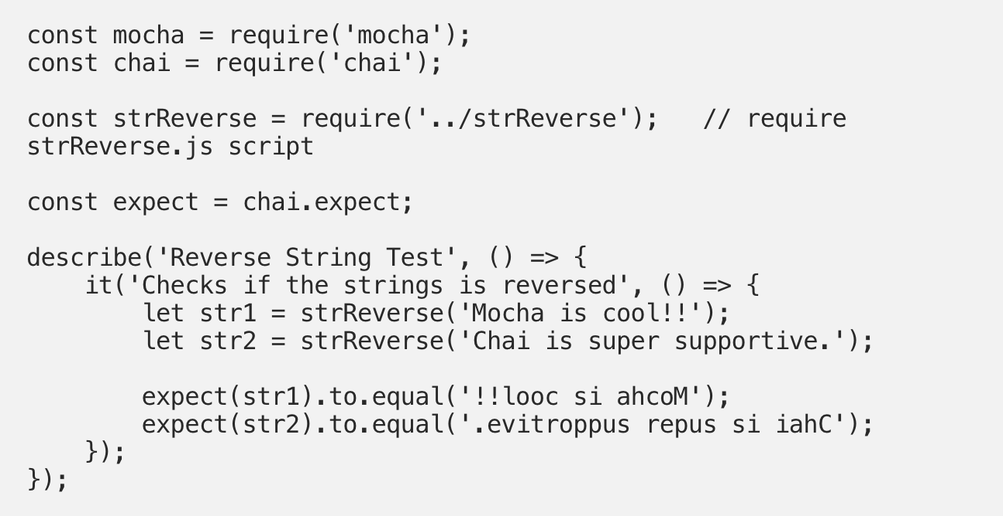

Slide 13
Istanbul
Istanbul instruments your ES5 and ES2015+ JavaScript code with line counters, so that you can track how well your unit-tests exercise your codebase.

Slide 14
What’s the Difference Between TDD and BDD?
In TDD (Test Driven Development), the test is written to check the implementation of functionality, but as the code evolves, tests can give false results. BDD (Behavior Driven Development) is also a test-first approach, but differs by testing the actual behavior of the system from the end users perspective.

Slide 15
In BDD, you are looking for the behavior, for example, what will happen to this system under a certain condition. But in TDD you have a test for a method which will assert some conditions, but as the system evolves these tests may give you false results
Since behavior in BDD is written in simple, descriptive English, your clients will be able to understand the tests and more quickly send their feedback. These more open lines of communication allow you to better incorporate their feedback to improve the tests and design of the software further. In TDD, only skillful programmers can understand the test, which of course, limits communication with the wider audience but this method will deliver code of a higher quality.

Slide 16


